Slide 1
Traffic dynamics in Transportation Networks
Rajarshi Basak
Course Project
CSCI - 5352 (Network Analysis and Modeling)
Fall 2018

Slide 2
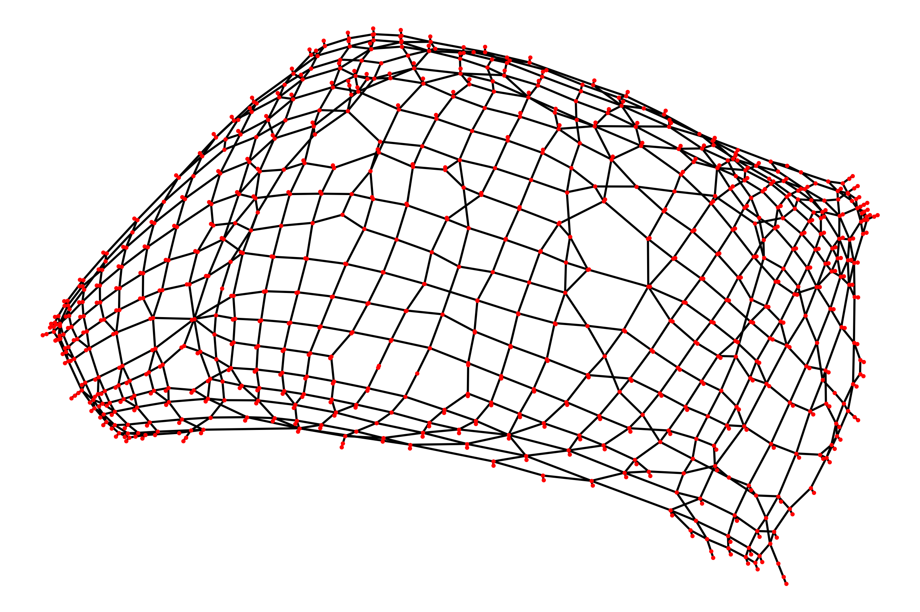
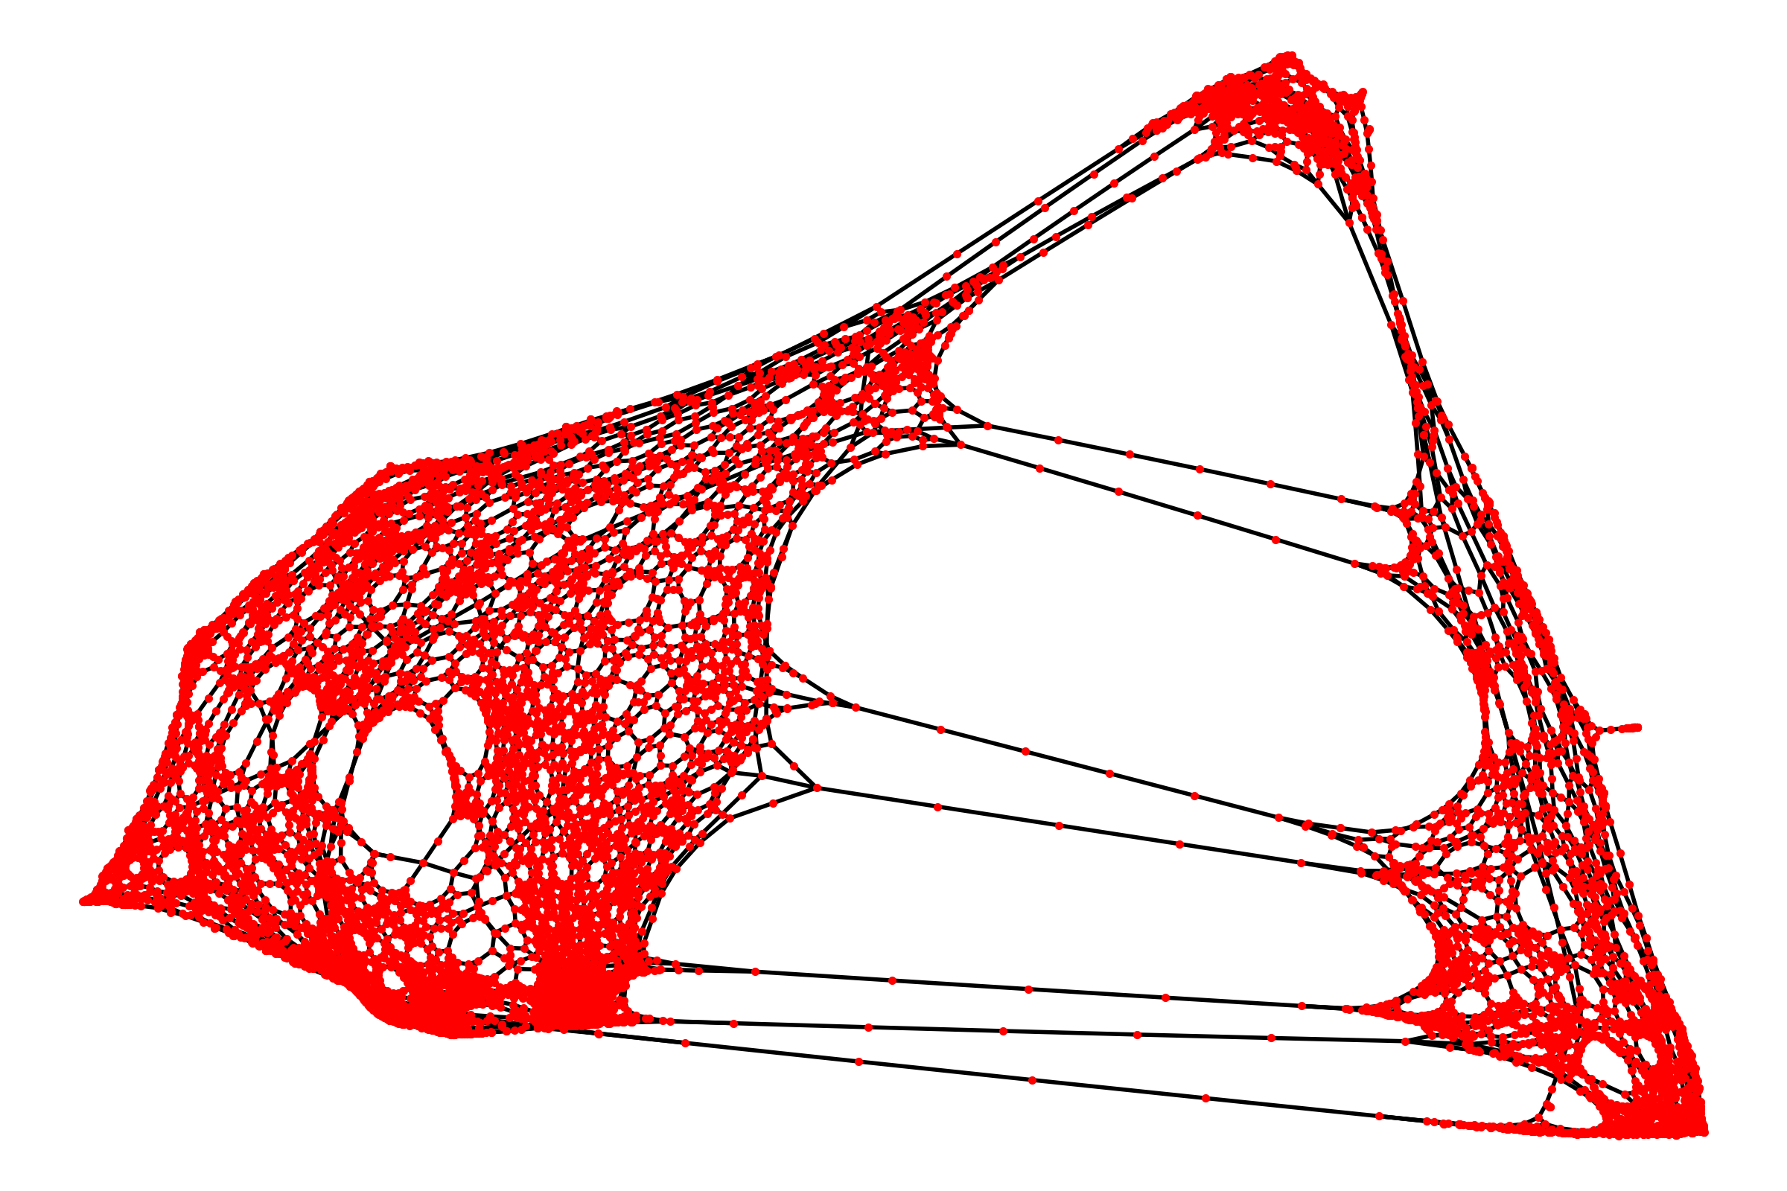
Introduction
Network of roads and junctions
Traffic flow between junctions
Anaheim, CA ; Chicago, IL ; Philadelphia, PA ; Austin, TX

Slide 3
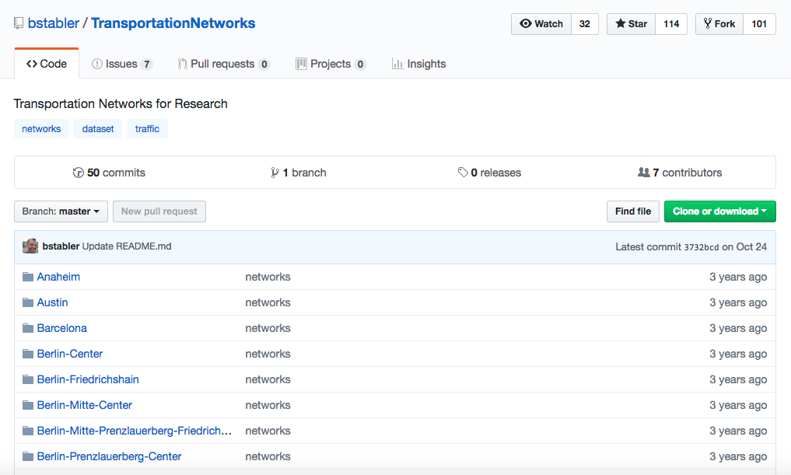

Data
https://github.com/bstabler/TransportationNetworks/tree/master/Anaheim

Slide 4
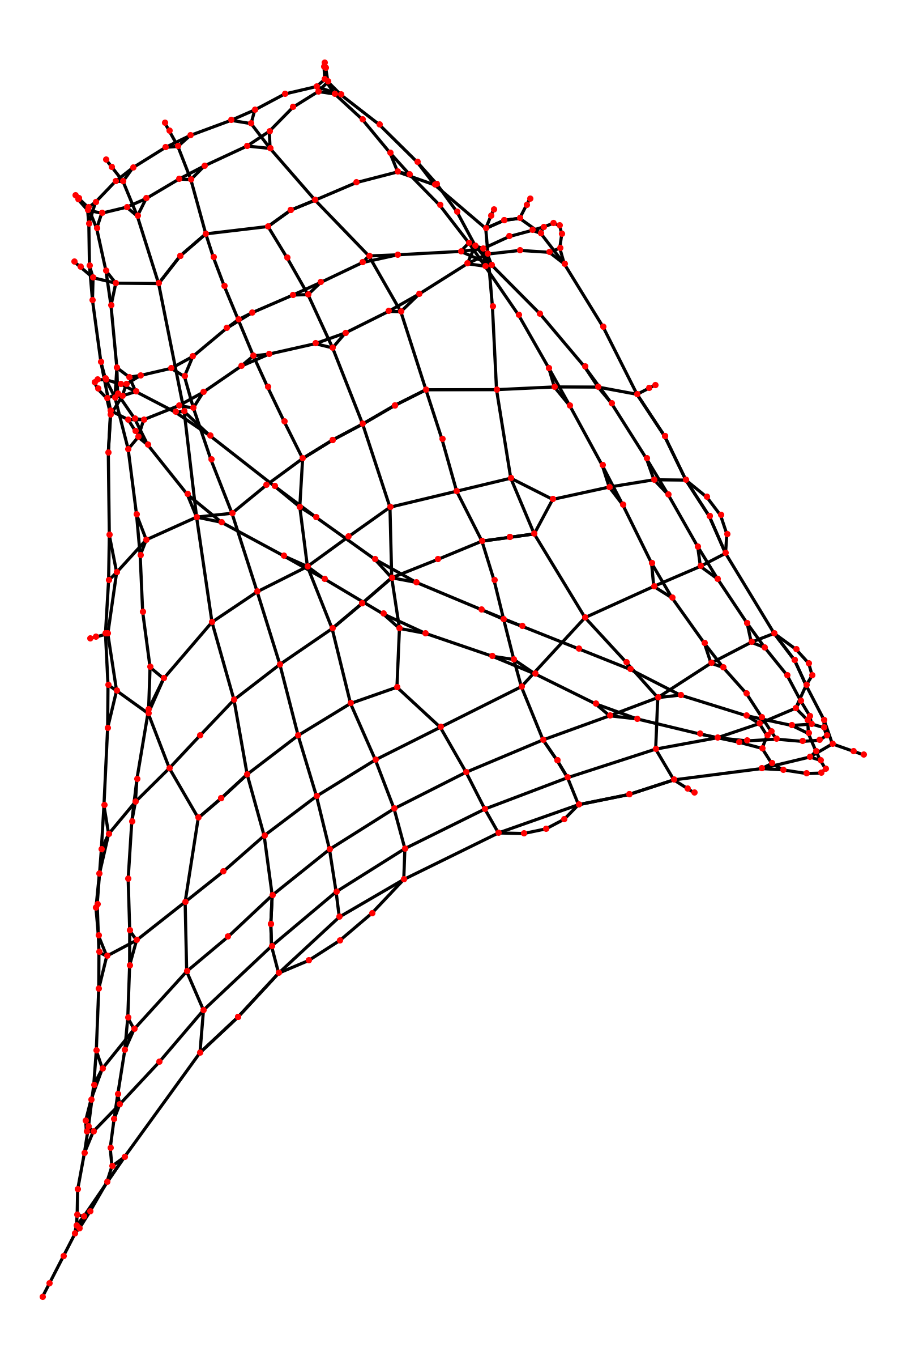
The Anaheim Network
1992
Files
Anaheim-flow.tntp
Anaheim-net.tntp
Anaheim-trips.tntp
.tntp -> .txt
416 nodes
914 edges
38 zones
Spectral plot (eigenvectors)

Slide 5
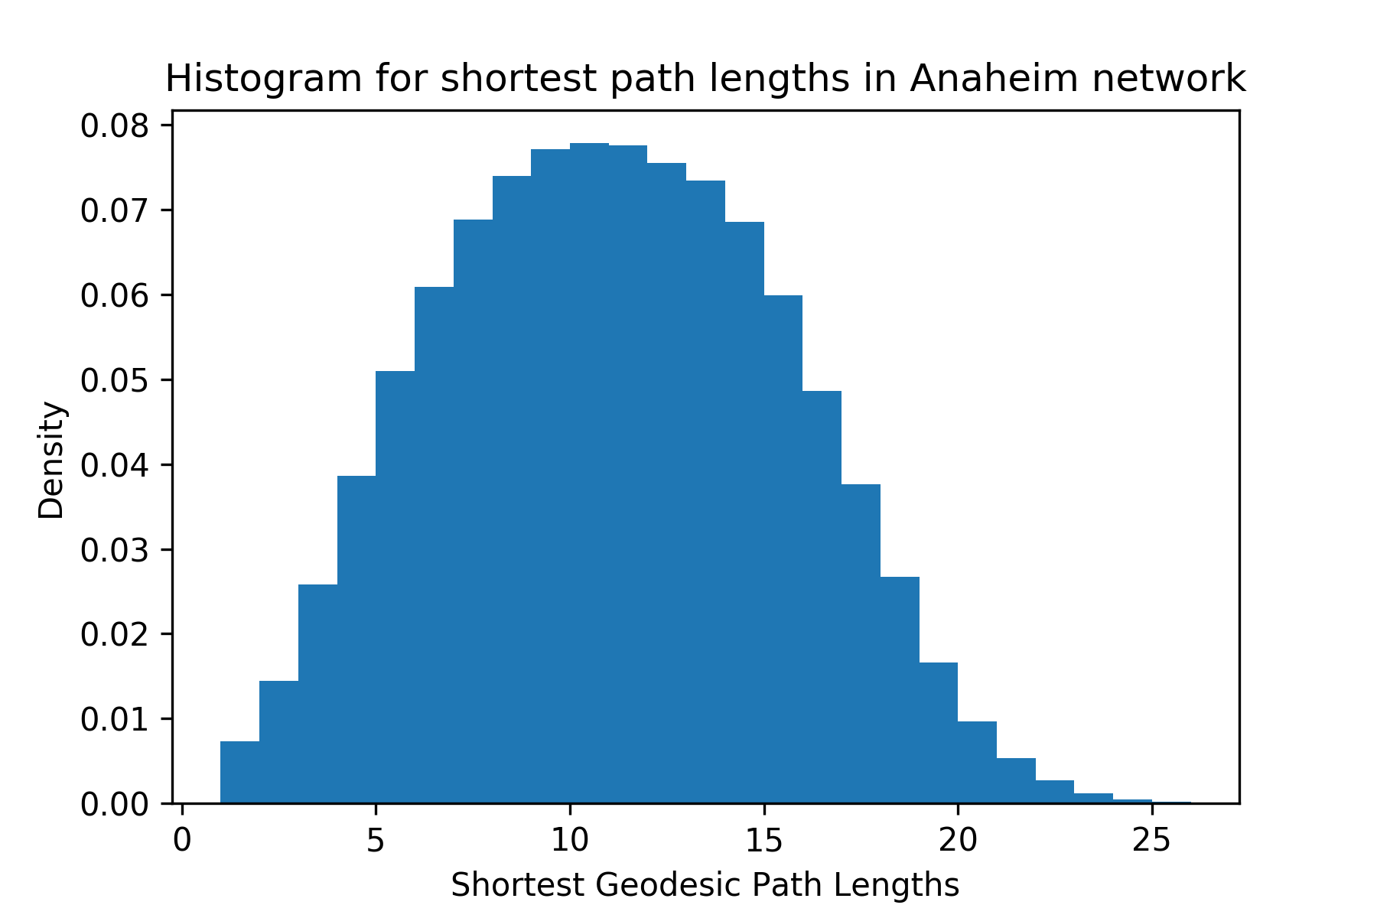
Shortest Paths (geodesics)

Slide 6
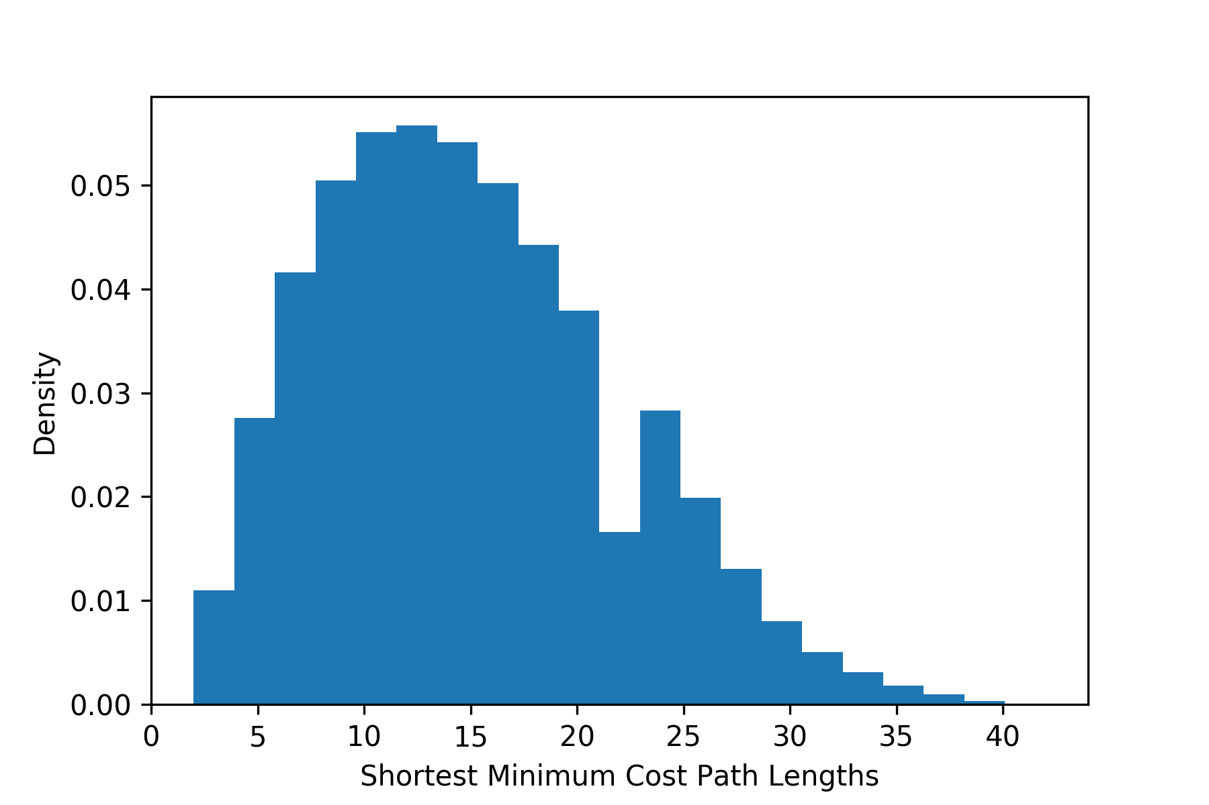
Shortest Paths (minimum costs)

Slide 7
Shortest Paths (geodesics = minimum costs) ?
Load graph (unweighted/weighted)
Shortest path (u/w) for all pairs
Dijkstra’s algorithm
Count paths for which u = w
Plot as a function of geodesic path length
Expectation
Large fraction equal for smaller geodesic path length
Fraction should decrease rapidly for larger path lengths

Slide 8
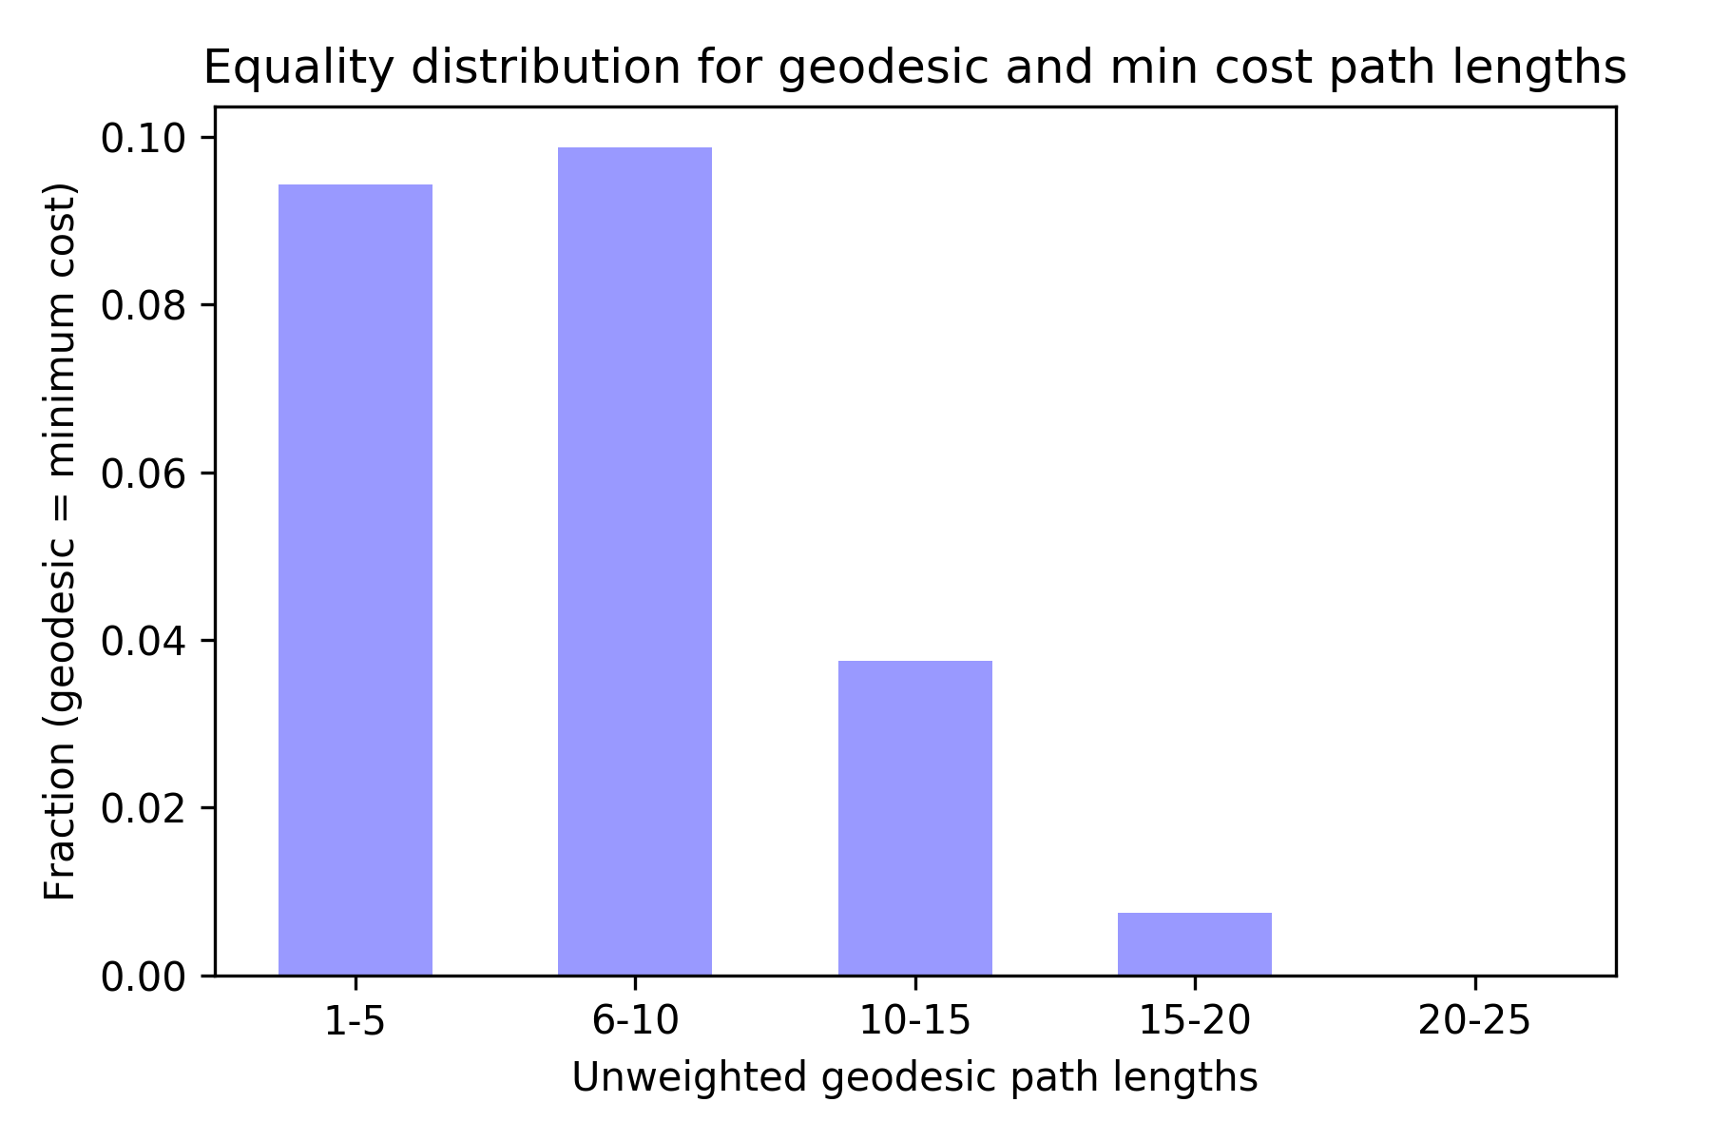
Shortest Paths (geodesics = minimum costs) ?

Slide 9
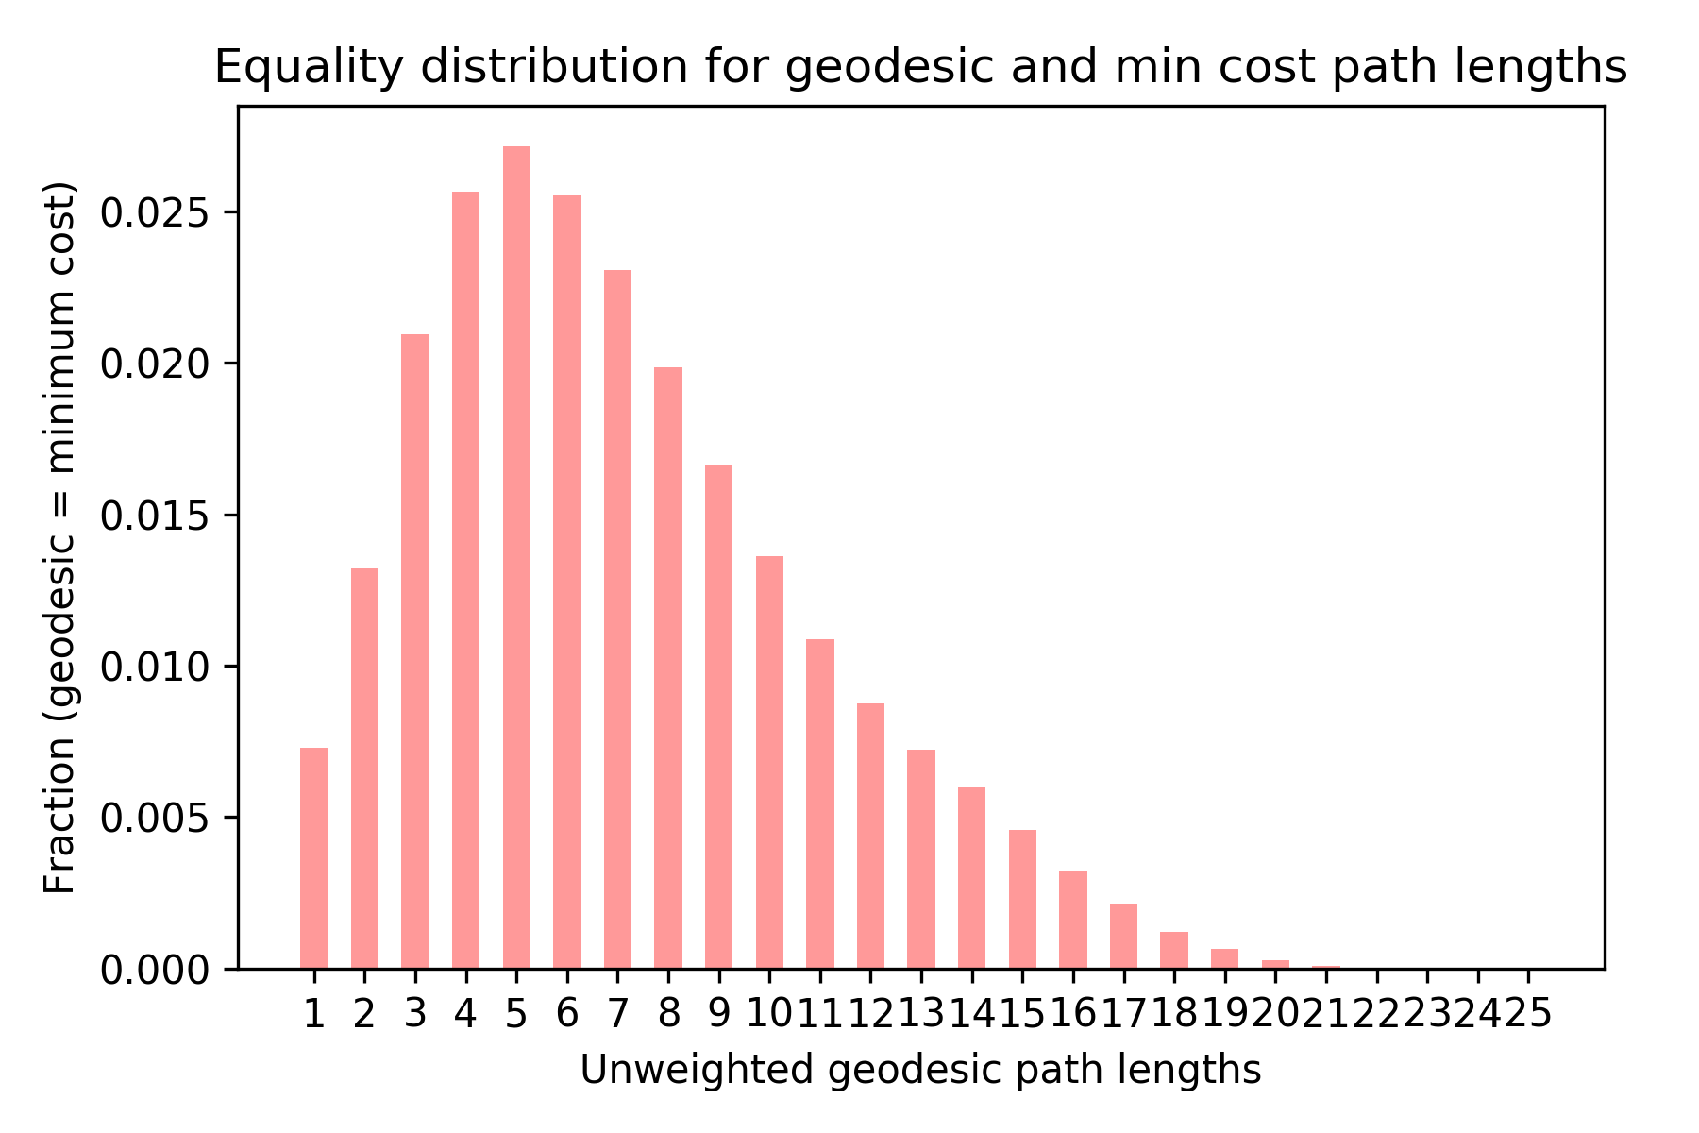
Shortest Paths (geodesics = minimum costs) ?

Slide 10
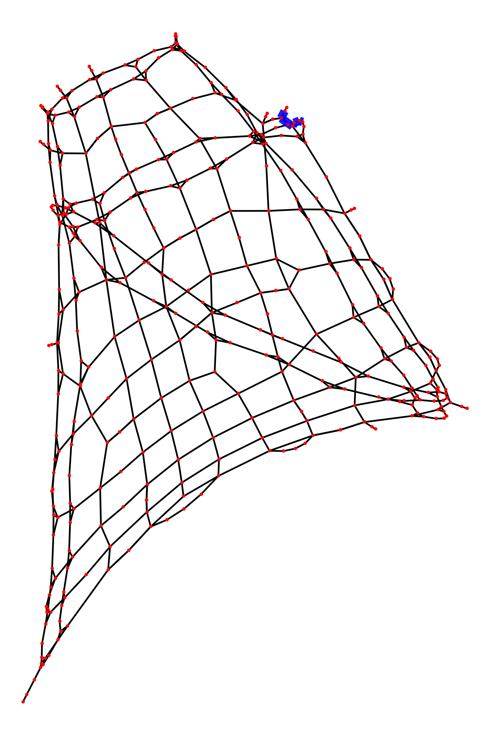
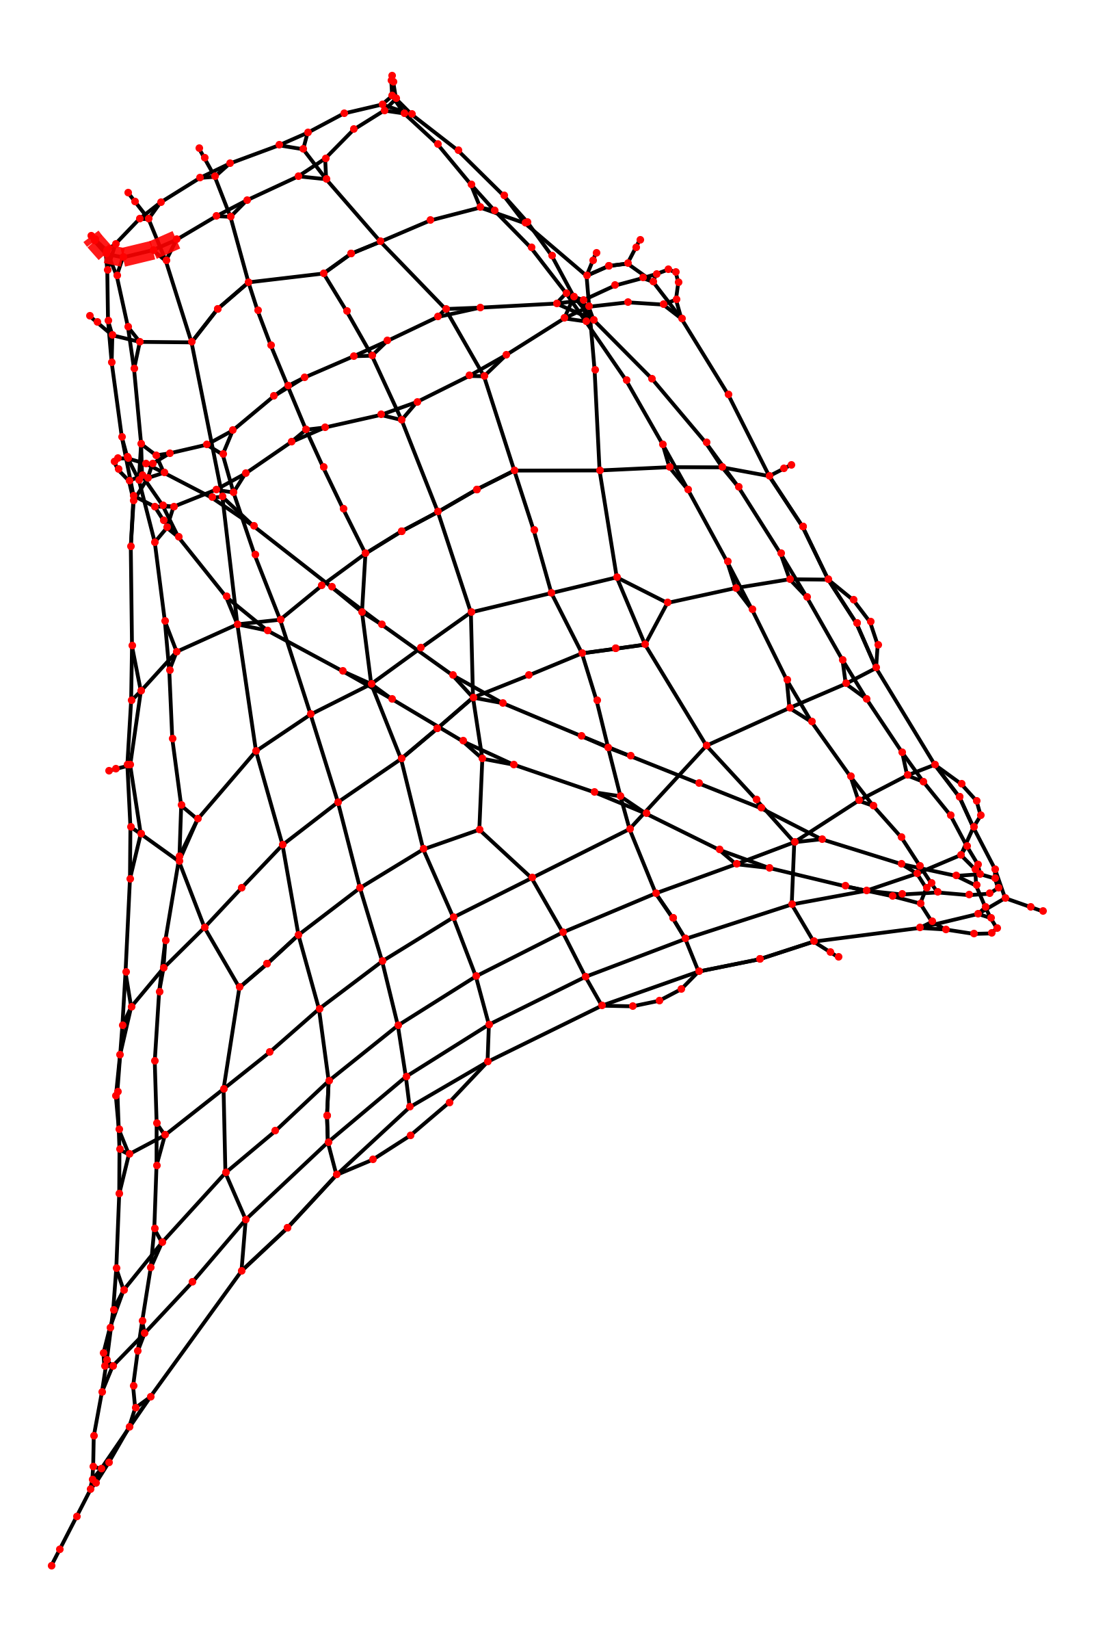
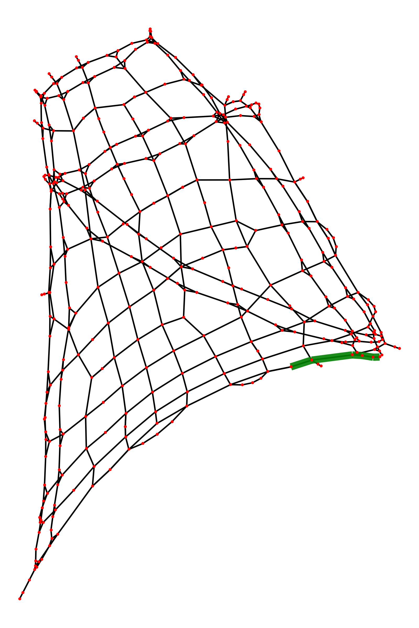
Shortest Paths (Path Length = 5)

Slide 11
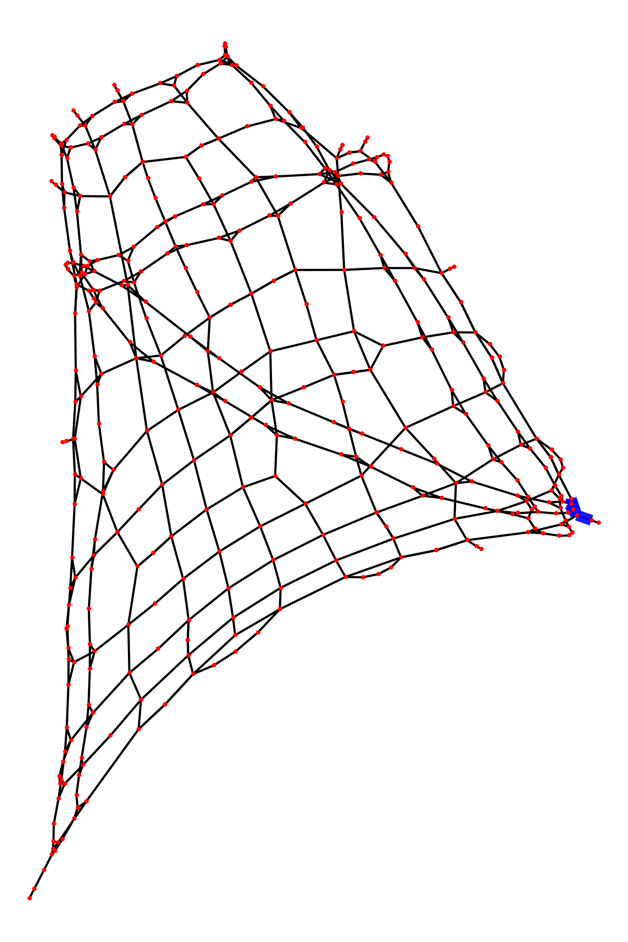
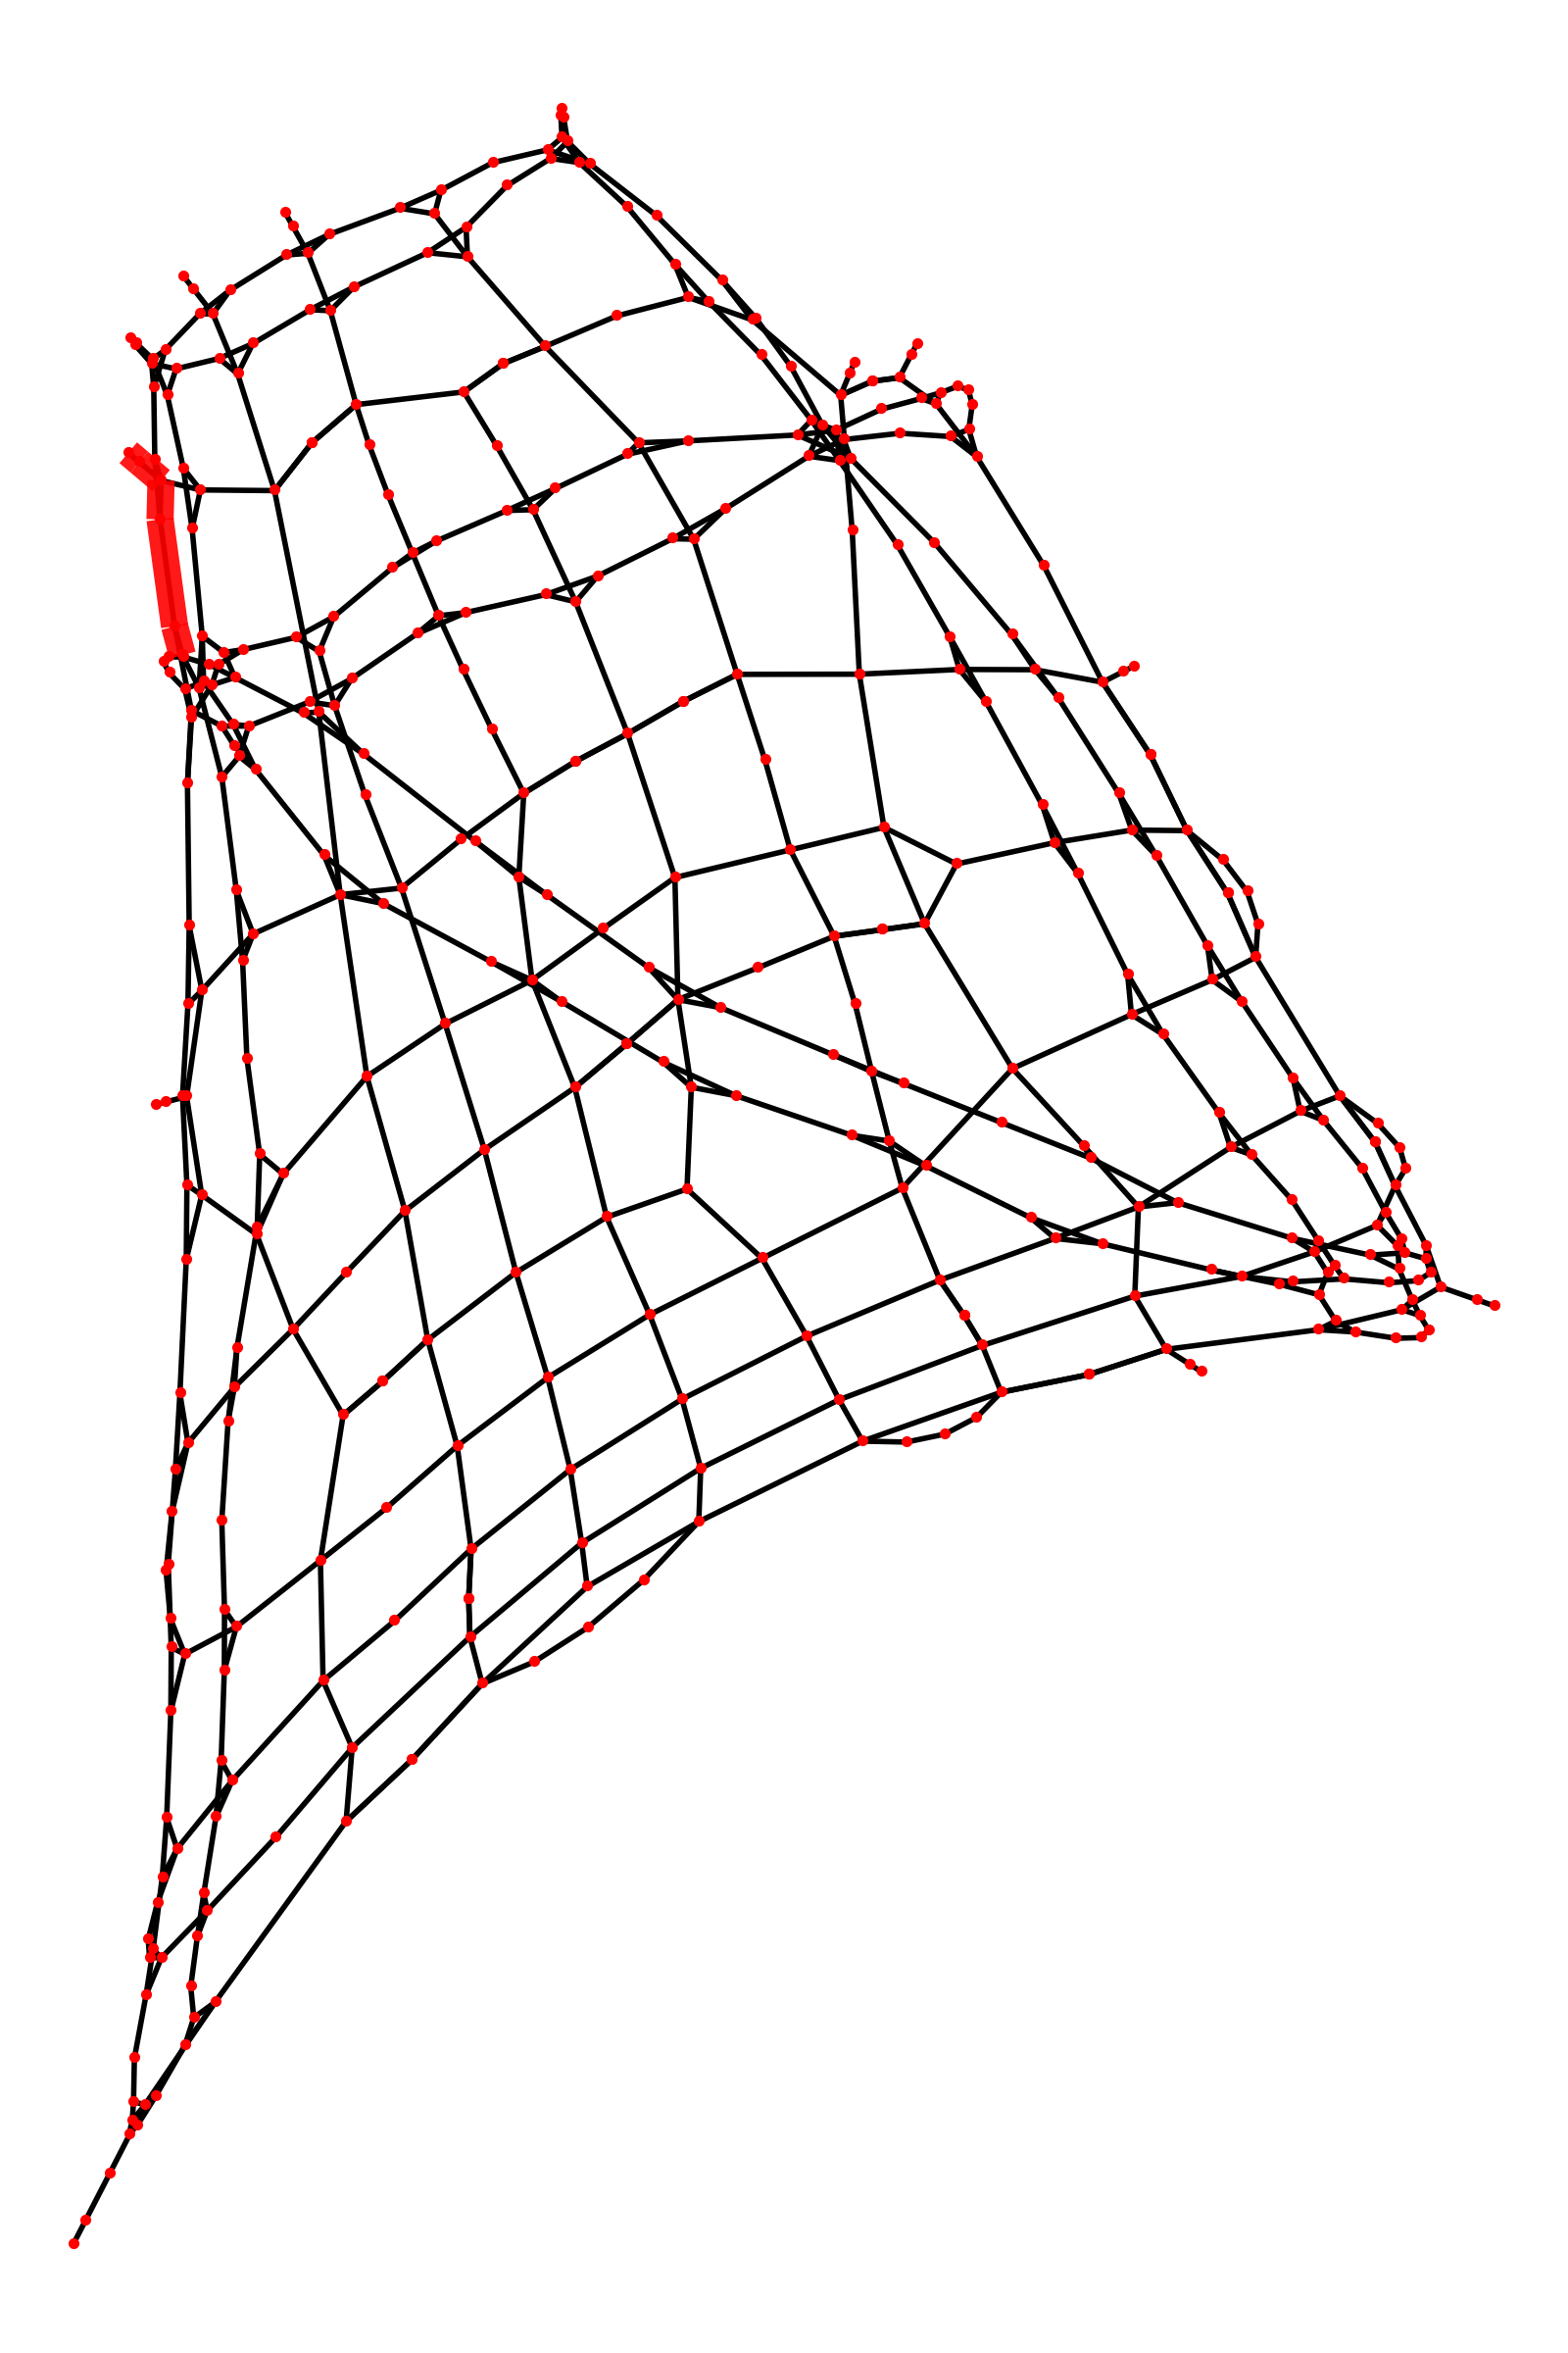
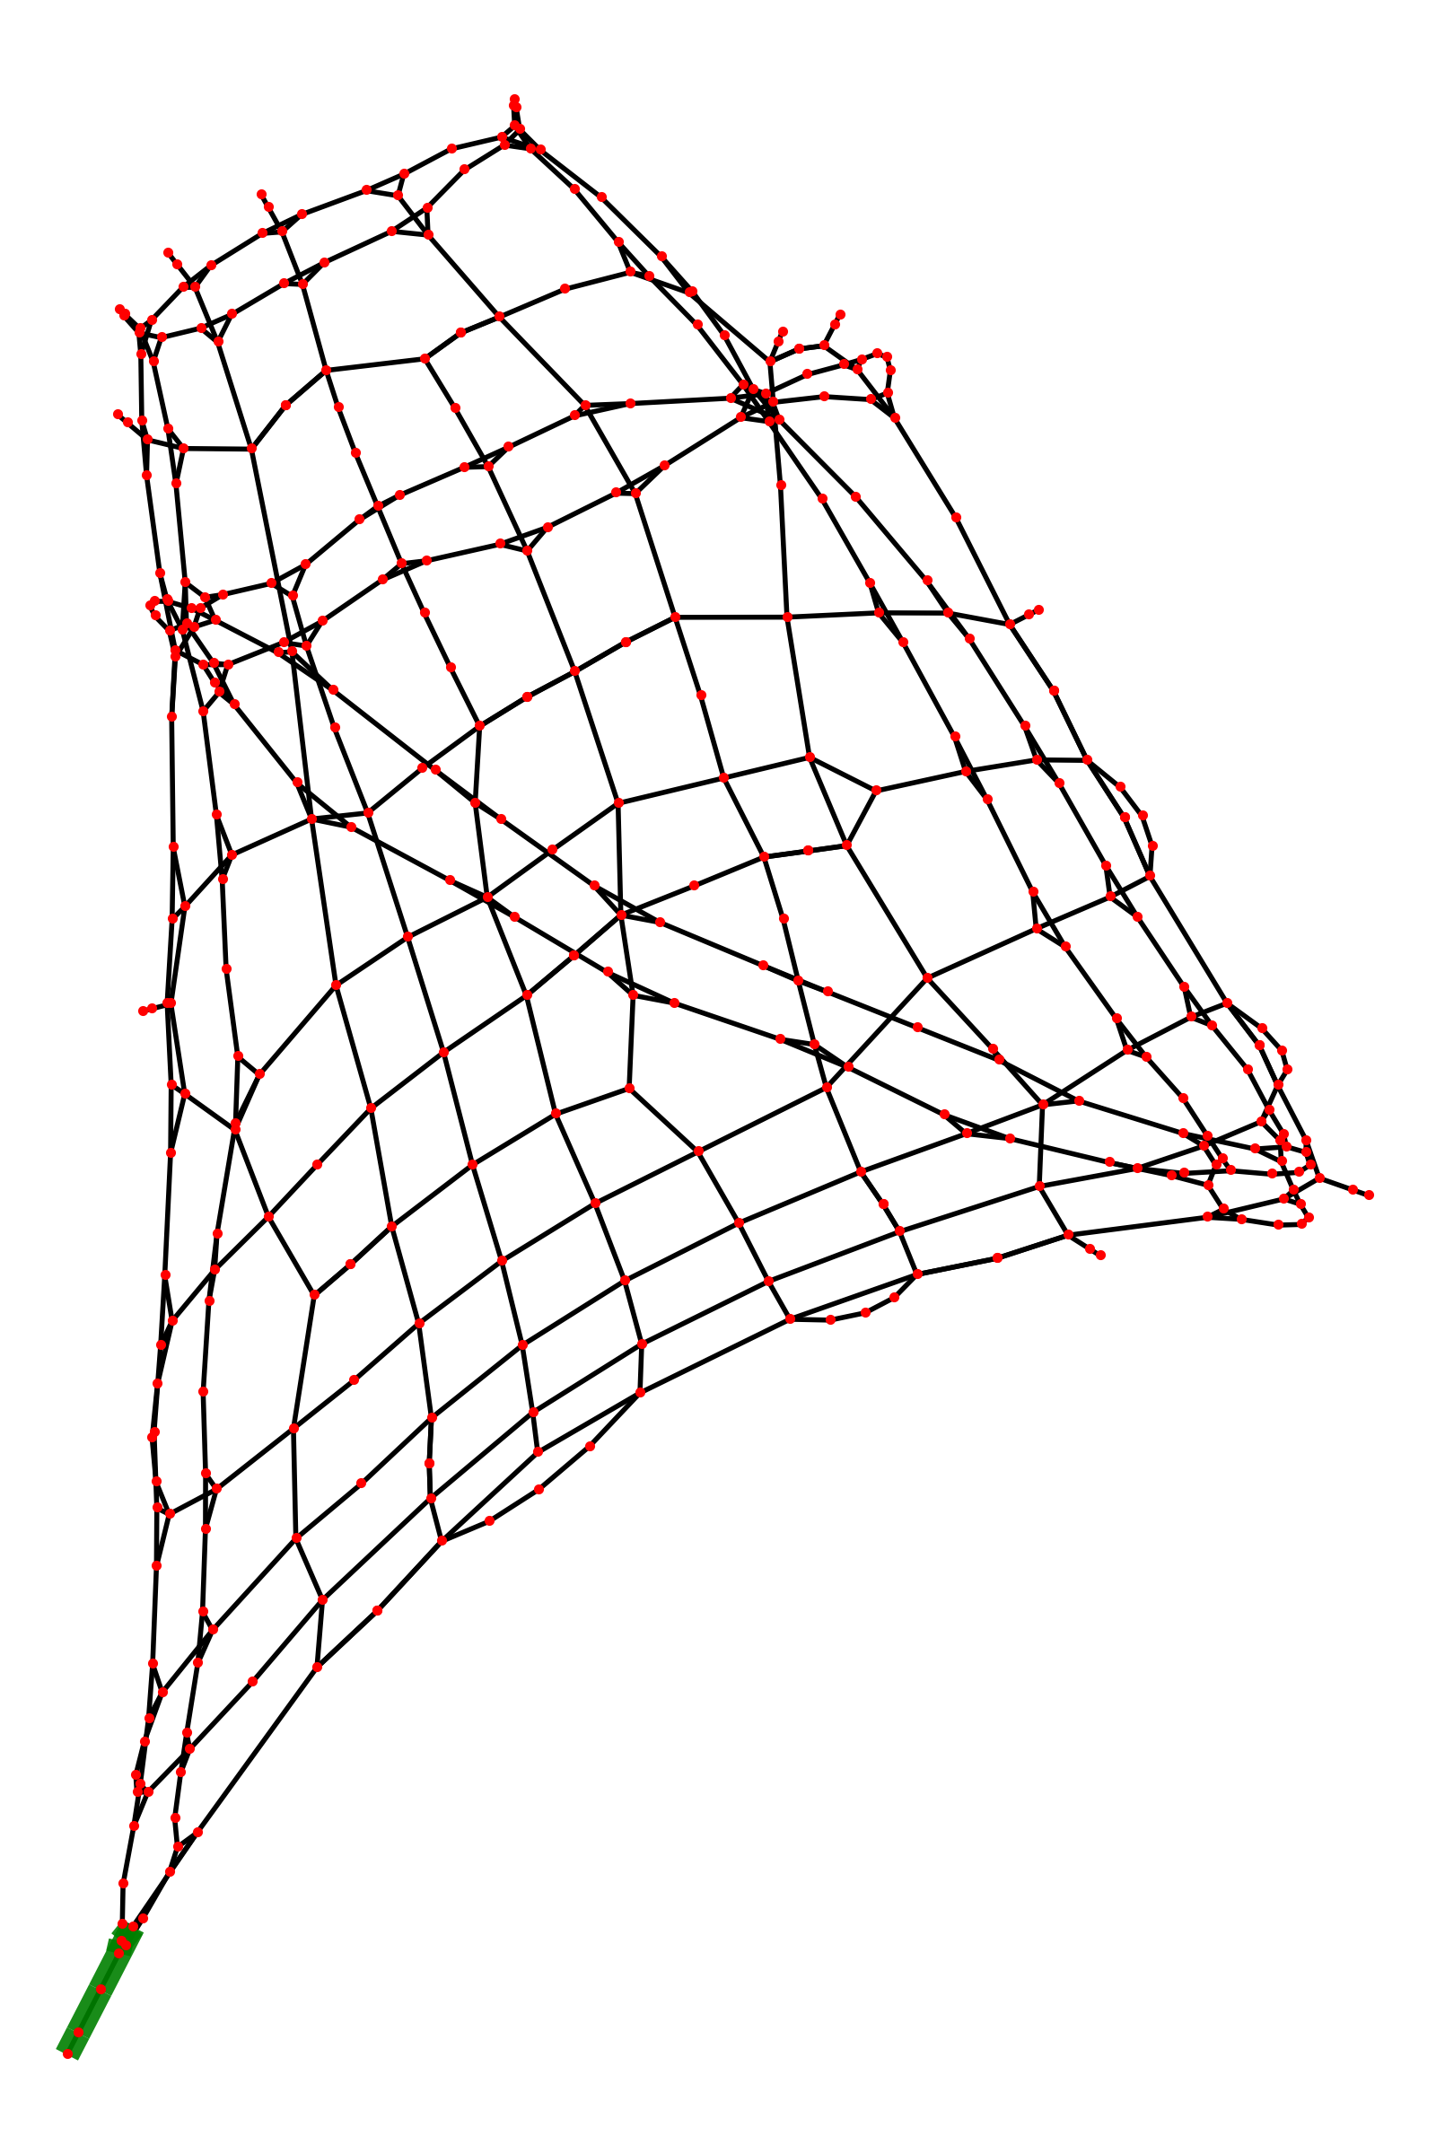
Shortest Paths (Path Length = 5)

Slide 12
Perturbations
Removing nodes
Removing edges
Removing nodes AND edges
Altering edge costs/attributes

Slide 13
Dynamical Importance of Nodes (Junctions)
Remove an edge
Block ALL traffic
Detour around that edge
Drop in overall transport speed
~ Increase in overall cost
Inspect shortest paths for all pairs before and after removing an edge
Fetch betweenness centrality of edge
Expectation : Higher the centrality of removed edge, higher the change (increase) in shortest path when edge is removed

Slide 14
Betweenness centrality for edges
Fraction of all paths that traverse through given edge
Current flow model
Resistance = Cost
Current = Traffic
Kirchoff’s Law of current distribution

Slide 15
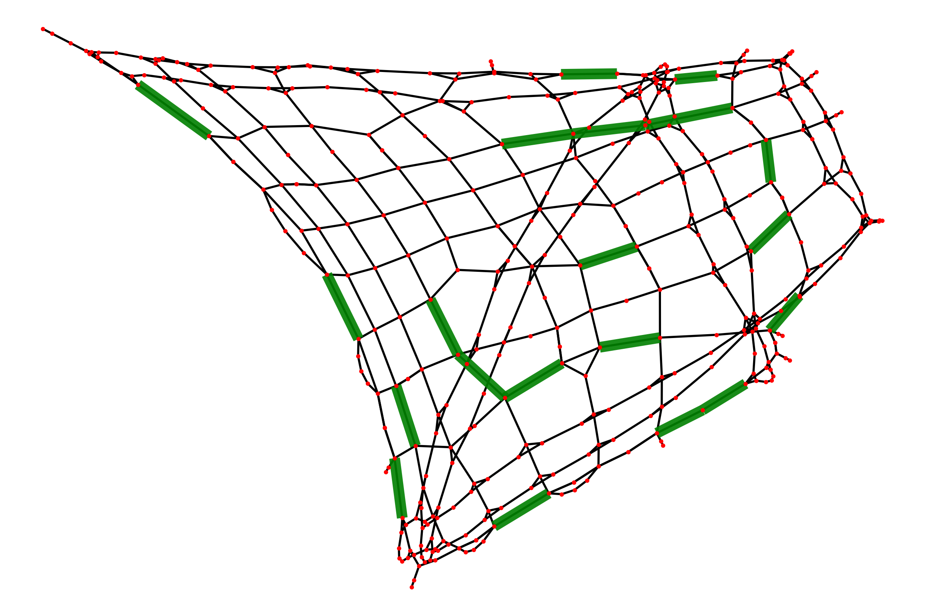
Betweenness centrality for edges (unweighted)
No conclusive evidence of why these edges have the highest betweenness

Slide 16
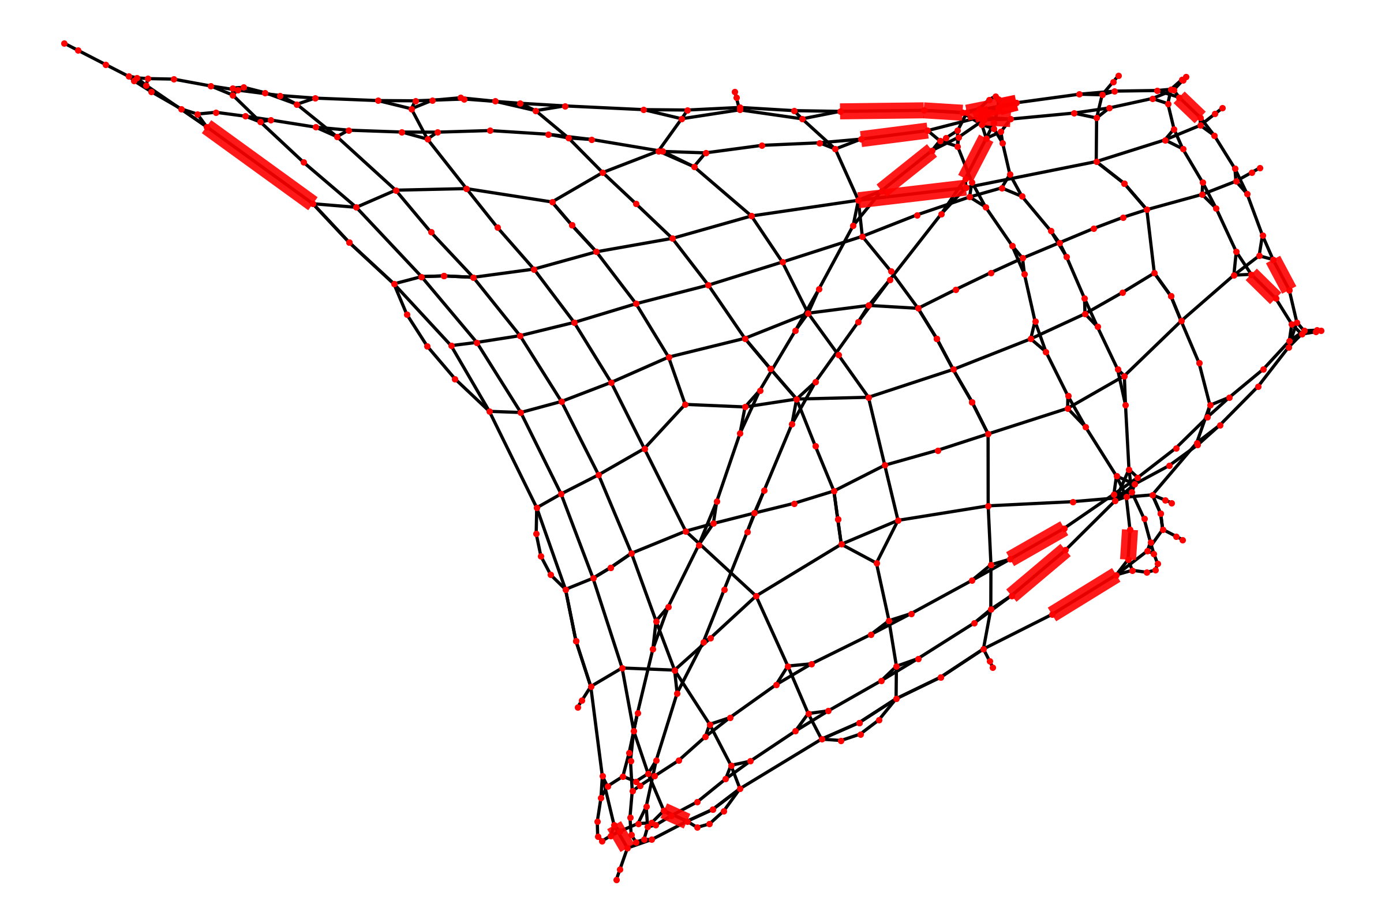
Betweenness centrality for edges (weighted)
Most edges are near the entry and exit of the diagonal paths and paths on the bottom.

Slide 17
Dynamical Importance of Nodes (Junctions)
Change in net shortest path length vs. betweennness centrality of removed edge
Unweighted
Weighted
Expectation : Greater the centrality, greater the drop in general
Correlation between centralities of edges for the weighted and unweighted case (when edge is removed)
Expectation : a 45 degree scatterplot
3d plot of change in total shortest path length as a function of weighted and unweighted centralities of removed edges
Expectation : a 45 degree scatterplot with a rise in z axis for larger values of both the centralities

Slide 18
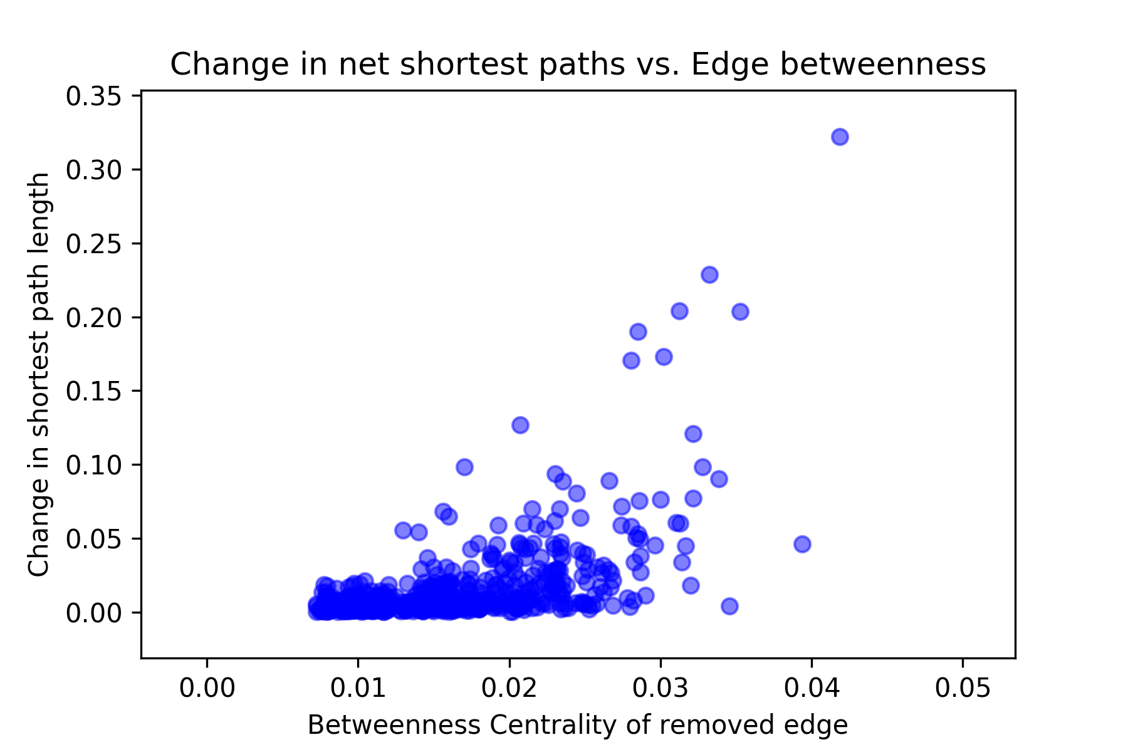
Dynamical Importance (Unweighted)
Cost before = 10.63
Most edges (even with high betweenness) don’t have a huge effect 0.01 - 0.03
A handful of edges have moderate effect 0.05 - 0.12
Only a few have a large effect that scales linearly 0.17 - 0.34

Slide 19
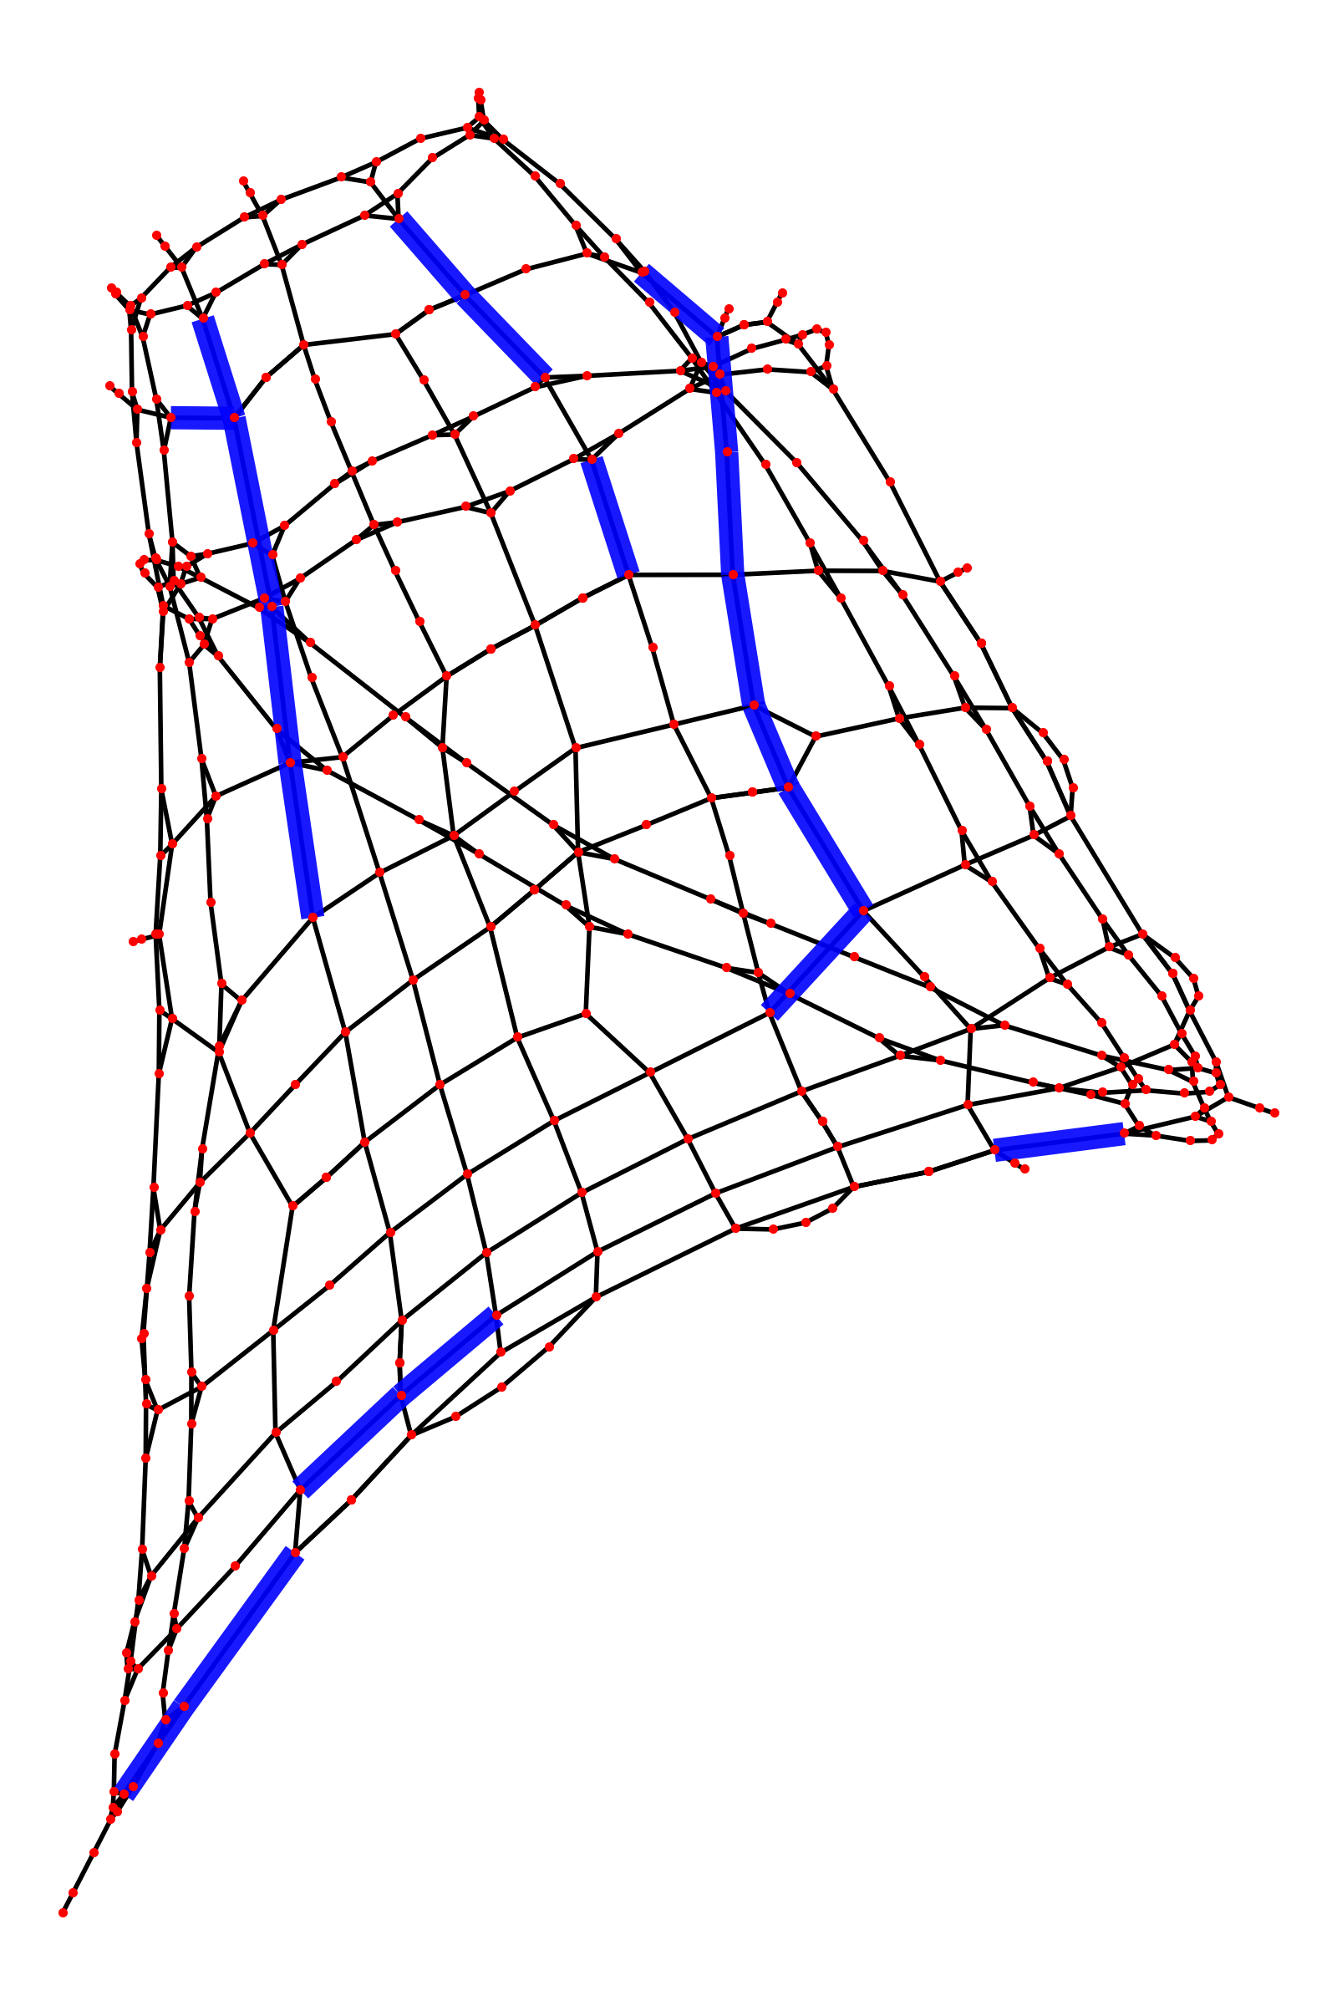
Dynamical Importance from betweenness
Some overlap between edges for highest betweenness centrality and highest change in net shortest path lengths when edge is removed
Highest Betweenness Centrality
Highest Change in Net Shortest Path length on removal of edge

Slide 20
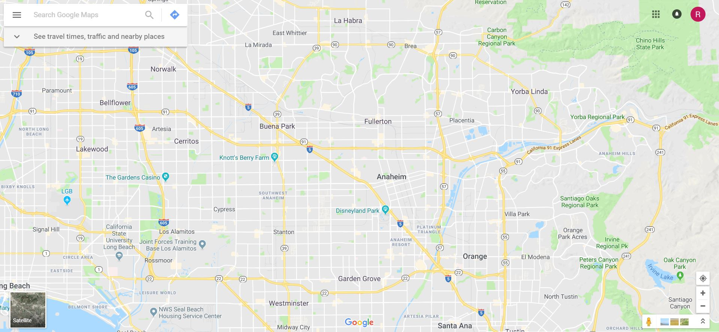
Current map of Anaheim (Google Maps)

Slide 21
References
Models and algorithms for road network design: a review and some new developments ; Hai Yang Michael,G. H. Bell; Pages 257-278; https://doi.org/10.1080/01441649808717016
A review of urban transportation network design problems; Reza Zanjirani Farahani, Elnaz Miandoabchi, W. Y. Szeto, Hannaneh Rashidi; https://doi.org/10.1016/j.ejor.2013.01.001
The Structure of Interurban Traffic: A Weighted Network Analysis; Andrea De Montis, Marc Barth ́elemy, Alessandro Chessa, Alessandro Vespignani; https://doi.org/10.1068/b32128

Slide 22
Thank you!

